Slide 1
Project M1: DAX Transpiler
Alexander Allen
Keith Mellendorf

Slide 2
Project Overview
QISKIT
Our goal was to interface a high-level quantum computing language (Qiskit / Q# / etc.) with Duke University’s ion-trap quantum system “ARTIQ”
We decided to build a Qiskit provider to compile Qiskit quantum circuits to DAX code which Duke can compile onto their ARTIQ device.
Qiskit Provider
DAX
ARTIQ Compiler
ARTIQ
Notes:
Duke University has an ion-trap quantum computer that runs on a hardware platform called ARTIQ which we will explain in detail in a few minutes. Our goals was to implement a translation layer between a high level language like Qiskit or Q# and the Duke Artiq Extensions (or DAX) language, a high level language that ARTIQ can be programmed in. We did this by developing a new provider for qiskit similar to how IBM cloud is an existing provider that quantum circuits can be run on.

Slide 3
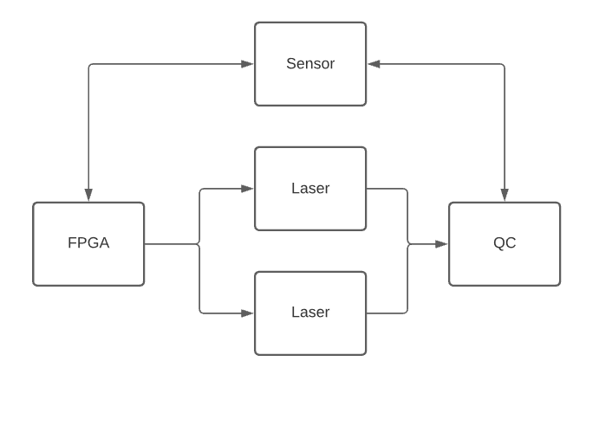
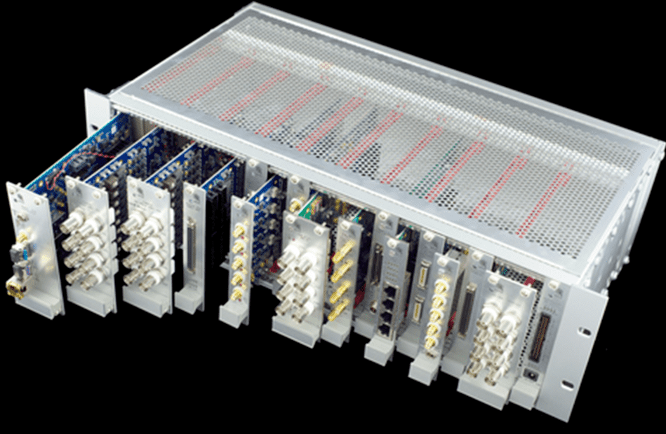
Duke’s Ion Trap Architecture
Notes:
So, what exactly is DAX? DAX is a device dependant high level programming language. It was made specifically to be compiled into kernels that can be run on the ARTIQ FPGA.
ARTIQ, or Advanced Real-Time Infrastructure for Quantum physics, is a control system for quantum experiments. That is what’s shown in this image on the left, a bunch of host processors and FPGA’s. Those FPGA’s will use the DAX code we generate and interface directly with emitters and sensors on the quantum computer. This is where the real time control of the QC happens when a quantum program is running.

Slide 4
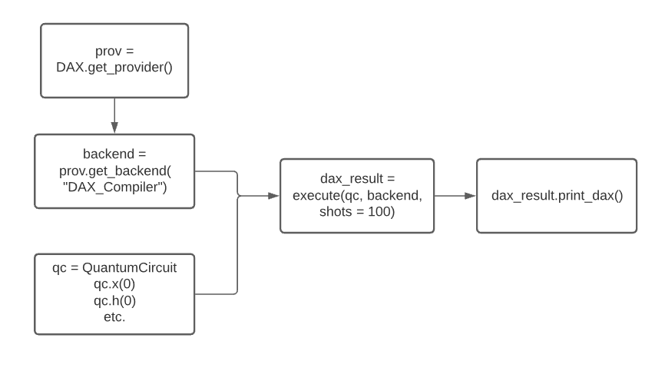
Qiskit Architecture
Notes:
To best talk about what we’ve achieved, I’ll first talk about how Qiskit’s Provider-backend infrastructure works. // to complete our project.
A provider is the host to some number of unique backends. Throughout this class we’ve been using two different IBM providers. ‘Aer’ holds the simulation backends such as “qasm_simulator” or “statevector_simulator”. When we want to run code on the real machine(s) we used the provider IBMQ with a backed that is named for a specific IBM machine.
Before we started developing our own code we utilized some of the work of the group Alpine Quantum Technologies, or AQT. They are Austrian company creating their own Ion Trap Quantum Computer. We were able to use a bit of their program infrastructure to aid in the development of our own provider and backend.
The use of our code is shown in this diagram. You can run a normal qiskit program with only a few changes needing to be made.
The big difference is how we utilize the return value from the execute() function. That function runs the qiskit function assemble, which turns our quantum circuit into a quantum object. Then it triggers the run function that is defined in our backend, which is where spent most of our development time. To use the resulting object we defined the method print_dax() which displays the transpiled quantum program.

Slide 5
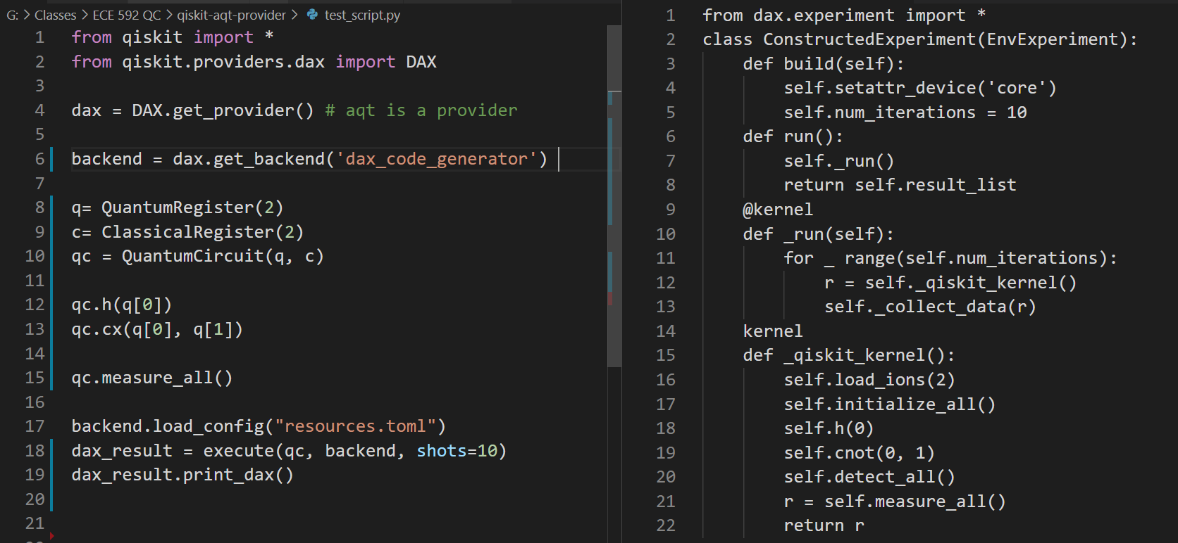
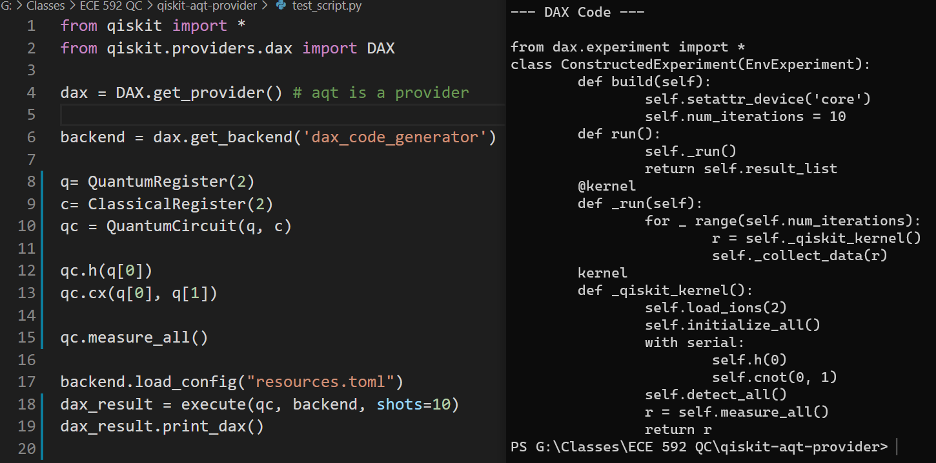
Translation Example
Notes:
This is one example of a normal qiskit program and the transpiled code that it generated.
Everything on the right before the _qiskit_kernel() definition is constant code that is always generated.
Though, a slight caveat to that statement is the self dot num iterations, which controls how many times we run the qiskit kernel. We set that value by giving the execute function the argument for quantity of shots.
As I previously explained, the execute function is what runs the code that we developed. At this point dax_result is of type daxJob, which is a class we defined that inherited from qiskit’s baseJob.
And finally, the print_dax() method that we call on the dax_result object on the left is what prints the code on the right.

Slide 6
Scheduling
qc = QuantumCircuit(3, 3)
qc.h(0)
qc.cx(0, 1)
qc.h(2)
ARTIQ requires explicit scheduling of individual qubit operations.
DAX supports this through the constructs:
with serial
with parallel
We built a configurable scheduler that considers the resource consumption of a given operation in Qiskit and explicitly schedules as necessary.
with parallel:
with serial:
self.h(0)
self.cnot(0, 1)
self.h(2)
Notes:
DAX is a very explicit language and does not benefit from the parallelism and optimization that is automatically implemented in qiskit and IBM-Q. In order to provide this optimization and functionality we created a scheduler for qiskit circruits to be explicitly implemented in DAX. This is done by both managing the resources that a particular gate operation consumes and also by managing the dependency and order of operations on qubits to ensure the same qubit isn’t operated on at the same time or out of order.
We define the used resources and time that a particular gate operation uses through a resources configuration file. Each gate is assigned a number of resources that it takes and also the time that it takes them. This is an abstract interface that can be refined into something more precise in the future.
As you can see here the hadamard and the cnot gate on qubits 0 and 1 are forced to be in order while the hadamard on qubit 2 can be done in parallel as it does not impact the other two.

Slide 7
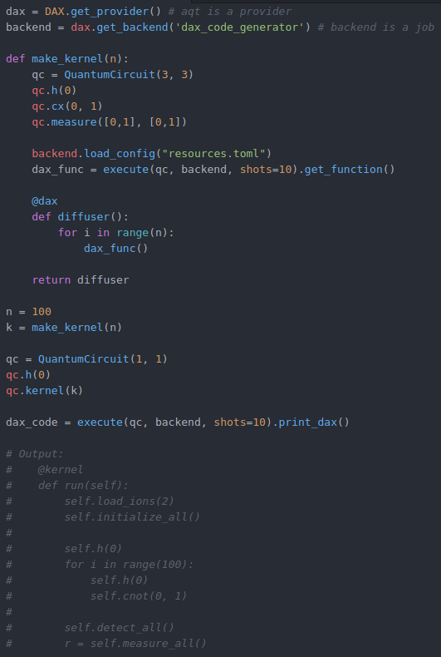
Future Work
The main component we are missing are classical constructs
The ARTIQ system supports running classical code on the FPGA so it is efficient to encode as much classical information into the quantum circuit encoded in DAX as possible.
Qiskit does not have good support for classical instructions within circuits.
We propose the following extension to Qiskit and our provider to resolve this...
Notes:
One weakness in qiskit is its poor support for classical constructs. This is especially impactful in our use case as it is much more efficient for the FPGA to execute any necessary classical operations rather than calling back to the host computer. This means that classical constructs should be embedded in the DAX code that we emit.
In order to support this we propose implementing the following extensions to qiskit. One being a DAX function decorator and the other being a kernel quantum gate operation.
We could then construct a small quantum circuit, such as the diffuser in grovers algorithm, and tell qiskit to compile it like earlier. However, we can take that compiled kernel and then embed it in a custom classical function with the dax decorator in order to integrate the classical operations (in this case repeating it n time as in grovers). Then we can simply apply this classical function to a quantum circuit just like a gate and re-execute the circuit to get a final, optimized and integrated DAX kernel. This allows the developer to use native python constructs to develop their classical kernel operations just as in DAX.

Slide 8
Any questions?

Slide 9
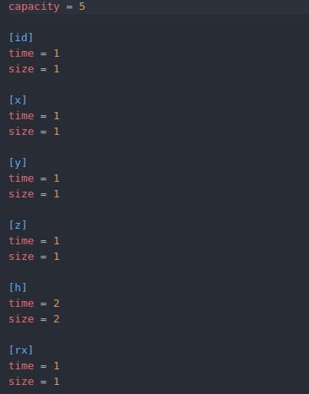
Appendix
Scheduler Configuration File

Slide 10
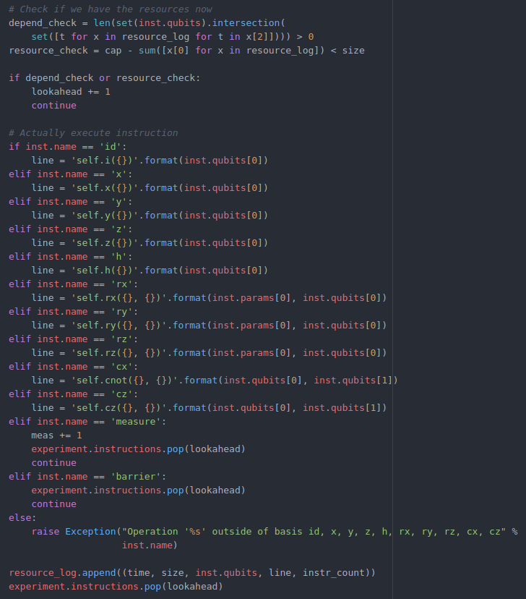
Appendix
QISKIT to DAX Translation Code

